Slide 1
Introductory NMR 101
❖ Chemical Shift
❖ Chemical Shift
❖ Peak Intensity
❖ Spin-spin Coupling
❖ Sample Preparation: Deuterated Solvents

Slide 2
Karplus (Garbisch) Relationships: Correlation of Magnitude of J Value w/ Geometry
❖ Spin-spin Coupling
J = C cos (2φ) + B cos (φ) + A
"where J is the ³J coupling constant, φ/phi is the dihedral angle, and A, B, and C are empirically derived parameters whose values depend on the atoms and substituents involved" (Wikipedia)
14
12
10
8
6
4
2
0

Slide 3
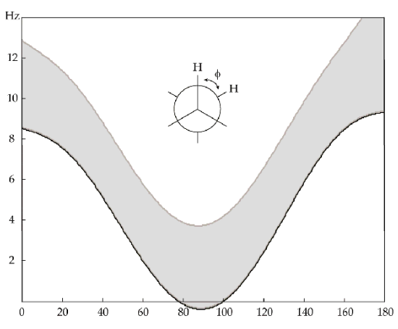
Karplus (Garbisch) Relationships: Actually, an Array of Curves
❖ Spin-spin Coupling
J = C cos (2φ) + B cos (φ) + A
"where J is the ³J coupling constant, φ/phi is the dihedral angle, and A, B, and C are empirically derived parameters whose values depend on the atoms and substituents involved" (Wikipedia)
J = C cos (2φ) + B cos (φ) + A
"where J is the ³J coupling constant, φ/phi is the dihedral angle, and A, B, and C are empirically derived parameters whose values depend on the atoms and substituents involved" (Wikipedia)

Slide 4
Use of Coupling Constant Data to Guide Stereochemical Assignments
❖ Spin-spin Coupling
1. Determine as many experimental coupling constants Jexp( ³J and ⁴J) as possible.
2. Subject each diastereomer to multiconformational search (e.g., Monte Carlo in MacroModel) to identify the family of stable conformational isomers and then compute the Boltzmann weighted coupling constants Jcalc for each diastereomer.
Calculate χ^{2’} between the experimental Js and the computed Js. The isomer with smallest χ^{2’} (best fit) is the proposed structure.
χ^{2’} = ∑(Jexp-Jcalc)²

Slide 5
Extracting Coupling Constants from First Order Multiplets
❖ Spin-spin Coupling
4096 J. Org. Chem. 1994, 59, 4096-4103
A Practical Guide to First-Order Multiplet Analysis in
¹H NMR Spectroscopy
Thomas R. Hoye,* Paul R. Hanson,^{1a} and James R. Vyvyan^{1b}
Department of Chemistry, University of Minnesota, Minneapolis, Minnesota 55455
Received March 11, 1994
    The ability to deduce the proper set of coupling constant (J) values from a complex first-order multiplet in a ¹H NMR spectrum is an extremely important asset. This is particularly valuable to the task of assigning relative configurations among two or more stereocenters in a molecule. Most books and treatises that deal with coupling constant analysis address the less useful operation of generating splitting trees to create the line pattern from a given set of J values. Presented here are general and systematic protocols for the converse--i.e., for deducing the complete set of J values from the multiplet. Two analytical methods (A. systematic analysis of line spacings and B. construction of what can be called inverted splitting trees) are presented first. A reasonably thorough and systematic set of graphical representations of common doublet of doublets (dd's), ddd's, and dddd's are then presented. These constitute a complementary method for identification of J's through visual pattern recognition. These approaches are effective strategies for extraction of coupling constant values from even the most complex first-order multiplets.

Slide 6
❖ Spin-spin Coupling

Slide 7
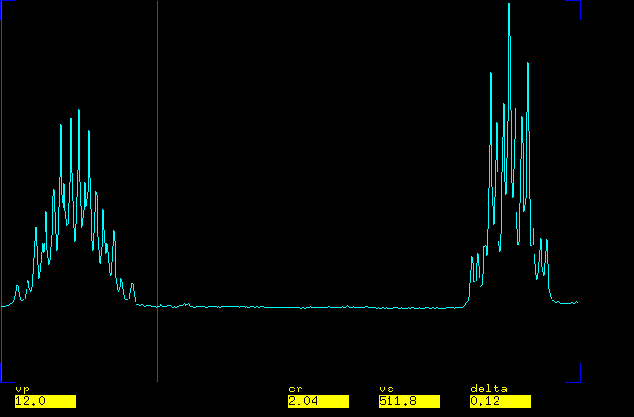
Extracting Coupling Constants from NMR Multiplets: An Addendum
❖ Spin-spin Coupling
H
H
"A Practical Guide to First-Order Multiplet Analysis in ¹H NMR Spectroscopy,"
Hoye, T. R.; Hanson, P. R.; Vyvyan, J. R. J. Org. Chem. 1994, 59, 4096-4103.
"A Method for Easily Determining Coupling Constants. An Addendum to …"
Hoye, T. R.; Zhao, H. J. Org. Chem. 2002, 67, 4014-4016.

Slide 8
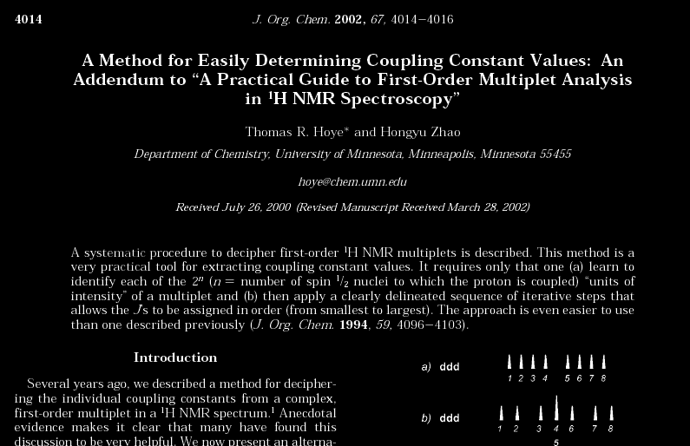
❖ Spin-spin Coupling

Slide 9
First (of Two) Steps to Identify all J’s in a Multiplet
❖ Spin-spin Coupling
1. Assign each peak in the multiplet one or more component numbers
from 1 to 2^{n} (arbitrarily) from left to right by analogy to the examples shown below.

Slide 10
❖ Spin-spin Coupling
2. Systematically identify the J's by the following series of steps. Adopt the convention that J₁ ≤ J₂ ≤ J₃ ≤ J₄ ≤ … J_{n}. Appreciate that for J₃ and beyond it is necessary to have first determined the previous coupling constants (e.g., both J₁ and J₂ must be known before J₃ can be determined). {1 to x} is the distance in Hz between component 1 (i.e., the lefthandmost peak) and component x.
i) {1 to 2} is, always, J₁
ii) {1 to 3} is, always, J₂
iii) remove from further consideration the component corresponding to (J₁ + J₂)
iv) {1 to next higher remaining component (i.e., 4 or 5)} is J₃
corollary: one of {1 to 4} or {1 to 5} is J₃
v) remove from further consideration the components corresponding to the remaining combinations
of the first three J values [i.e., (J₁ + J₃), (J₂ + J₃), and (J₁ + J₂ + J₃)
vi) {1 to the next higher remaining component} is J₄
corollary: one of {1 to 5} through {1 to 9} is J₄

Slide 11
Application to a dddd (2⁴ = 16)
❖ Spin-spin Coupling

Slide 12
❖ Spin-spin Coupling
2. Systematically identify the J's by the following series of steps. Adopt the convention that J₁ ≤ J₂ ≤ J₃ ≤ J₄ ≤ … J_{n}. Appreciate that for J₃ and beyond it is necessary to have first determined the previous coupling constants (e.g., both J₁ and J₂ must be known before J₃ can be determined). {1 to x} is the distance in Hz between component 1 (i.e., the lefthandmost peak) and component x.
i) {1 to 2} is J₁
ii) {1 to 3} is J₂
iii) remove from further consideration the component corresponding to (J₁ + J₂)
iv) {1 to next higher remaining component (i.e., 4 or 5)} is J₃
corollary: one of {1 to 4} or {1 to 5} is J₃
v) remove from further consideration the components corresponding to the remaining combinations
of the first three J values [i.e., (J₁ + J₃), (J₂ + J₃), and (J₁ + J₂ + J₃)
vi) {1 to the next higher remaining component} is J₄
corollary: one of {1 to 5} through {1 to 9} is J₄

Slide 13
Application to a dddd (2⁴ = 16)
❖ Spin-spin Coupling

Slide 14
❖ Spin-spin Coupling
2. Systematically identify the J's by the following series of steps. Adopt the convention that J₁ ≤ J₂ ≤ J₃ ≤ J₄ ≤ … J_{n}. Appreciate that for J₃ and beyond it is necessary to have first determined the previous coupling constants (e.g., both J₁ and J₂ must be known before J₃ can be determined). {1 to x} is the distance in Hz between component 1 (i.e., the lefthandmost peak) and component x.
i) {1 to 2} is J₁
ii) {1 to 3} is J₂
iii) remove from further consideration the component corresponding to (J₁ + J₂)
iv) {1 to next higher remaining component (i.e., 4 or 5)} is J₃
corollary: one of {1 to 4} or {1 to 5} is J₃
v) remove from further consideration the components corresponding to the remaining combinations
of the first three J values [i.e., (J₁ + J₃), (J₂ + J₃), and (J₁ + J₂ + J₃)
vi) {1 to the next higher remaining component} is J₄
corollary: one of {1 to 5} through {1 to 9} is J₄

Slide 15
Application to a dddd (2⁴ = 16)
❖ Spin-spin Coupling

Slide 16
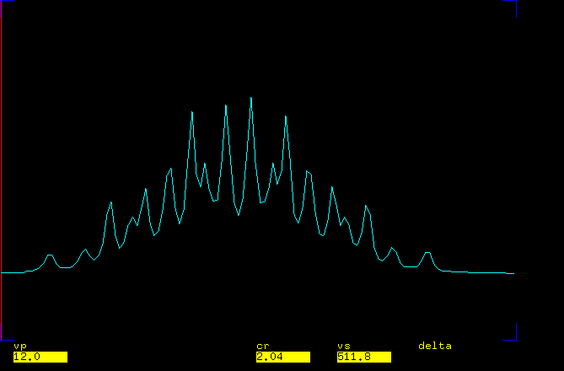
Assigning Component #’s is Harder for Some Multiplets (e.g., dddddd)
❖ Spin-spin Coupling

Slide 17
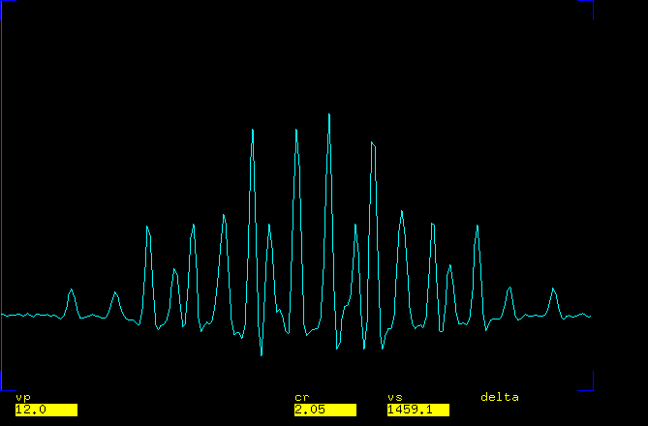
Resolution Enhancement: Relative Line Intensity Now Easier
❖ Spin-spin Coupling
6
8
3
3
5
3
2
1
1

Slide 18
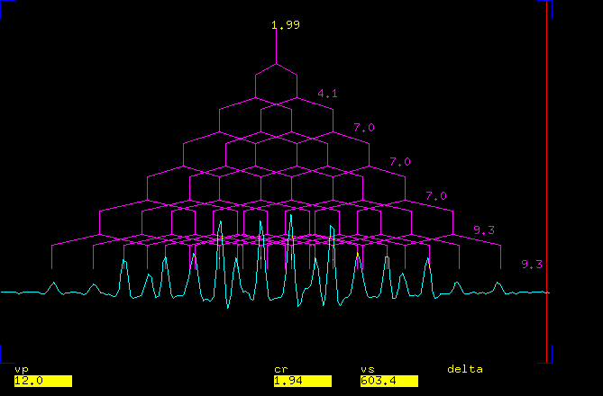
Splitting Tree: to Confirm the Assignments
❖ Spin-spin Coupling

Slide 19
Spiruchostatins A and B: A Challenging Opportunity to Test the Method
❖ Spin-spin Coupling

Slide 20
Strategies for Ferreting Out the Js
❖ Spin-spin Coupling
To overcome peak broadening:
a) Variable temperature NMR
b) Resolution enhancement
To overcome peak overlap:
    Mixed solvents: benzene-d₆ “titration”
    Complementary field strengths

Slide 21
Variable Temperature NMR
❖ Spin-spin Coupling
60 °C
25 °C

Slide 22
Resolution Enhancement Gives Critical 3’’’-H (ddddd) Js
❖ Spin-spin Coupling
For easy deconvolution of
first order Js see:
Hoye, T. R.; Zhao, H.
J. Org. Chem. 2002,
67, 4014-4016.
60 °C

Slide 23
Resolution Enhancement (cont’d)
❖ Spin-spin Coupling

Slide 24
Overcome Peak Overlap by Mixed Solvent ( 17 % Benzene-d₆ in CDCl₃)
❖ Spin-spin Coupling
17 % C₆D₆
60 °C
0 % C₆D₆

Slide 25
